Slide 1
Dimensionality Reduction
CS3300 Data Science

Slide 2
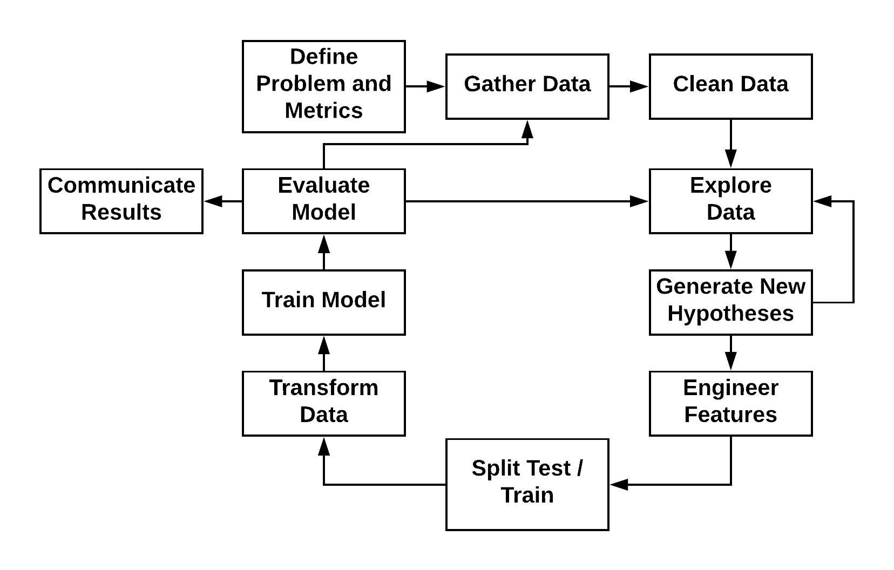
Machine Learning Process

Slide 3
High-Dimensional Data
Data with more than low 10's of dimensions (variables)
Cannot analyze individual variables by hand
Examples
Text data
Genomic data
Clickstream (user-product interaction) data
Need other approaches

Slide 4
Curse of Dimensionality
High dimensional data sets can pose a number of problems
As features are added the volume of our space increases exponentially
We have seen that statistical methods (and confidence) are dependent on number of samples
Fitting methods require traversing this space (or a proportionally sized space)
As this volume grows, the number of observations required to fill this space grows with it
Occam's Razor
We want to keep our models as simple as possible.
Models with higher degrees of freedom are at a greater risk of overfitting

Slide 5
Correlated Data
In a similar vein as the curse of dimensionality, with high dimensional data we have to care about correlated data.
Variable correlation
We want our features correlated with the response – this leads to good predictions
We want to minimize the correlation between our features

Slide 6
Dealing with the Curse of Dimensionality
Simple Models
Regularization
Dimensionality Reduction
Feature Selection
Feature Extraction

Slide 7
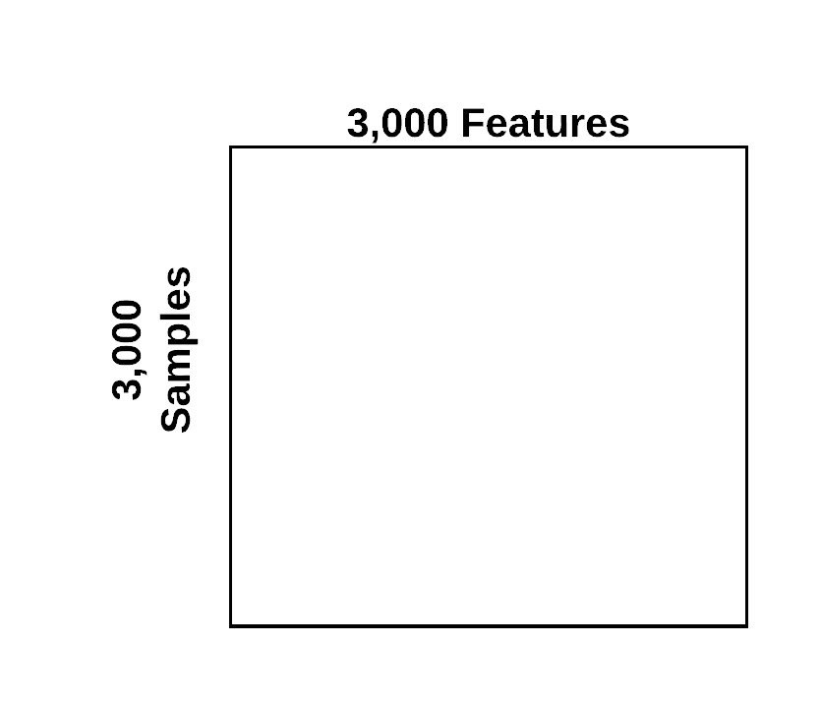
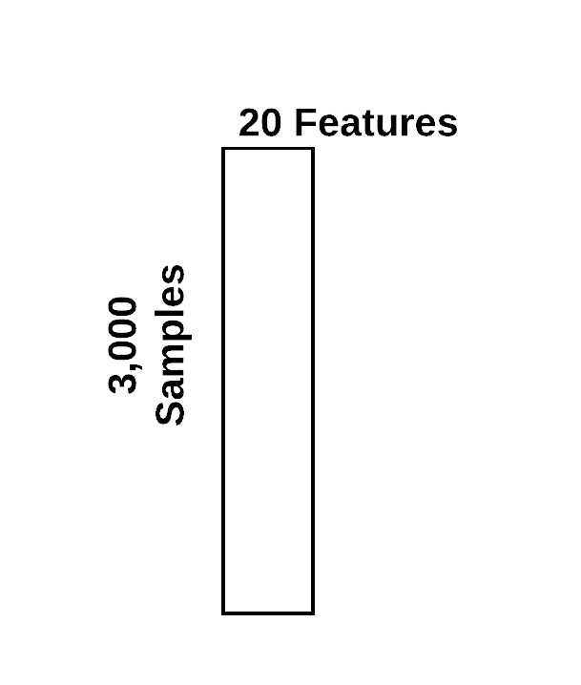
Dimensionality Reduction

Slide 8
Feature Selection
Selecting features that are predictive or important to the response from the existing features.
Approaches for feature selection
Reliance on subject matter expertise
Supervised learning approaches

Slide 9
Feature Selection
Context of Linear Models
ML models assign weights to each feature
Features that are predictive of the outcome get high weights
Features that are noisy or not predictive get low weights
Training a model is effectively the process of learning the weights that give the best predictions

Slide 10
Feature Selection
Considerations for supervised feature selection
We may not want to leave the feature selection up to the model
Hard to interpret feature importance and interactions
Improve predictive performance

Slide 11
Greedy Forward Feature Selection
Calculate features' predictive power
Build a separate model for each feature
Evaluate predictive performance of each feature
Sort features from most to least predictive
Greedy algorithm
Initialize current model to model with no features
Create candidate model
Add next feature to model
If new model is better, replace current model
Otherwise, discard feature and new model
Return list of features in final model

Slide 12
Greedy Backward Feature Elimination
Calculate features' predictive power
Build a separate model for each feature
Evaluate predictive performance of each feature
Sort features from least to most predictive
Greedy algorithm
Initialize current model to model with all features
Create candidate model
Remove feature from current model
If new model is better, replace current model and discard feature
Otherwise, keep feature and current model
Return list of features in final model

Slide 13
Feature Extraction
Creating new and more relevant features (for prediction) from the original data
Methods
(Linear) Matrix Factorization Methods
Principal Component Analysis (PCA)
Non-Negative Matrix Factorization (NMF)
t-Distributed Stochastic Neighbor Embedding (t-SNE)
Uniform Manifold Approximate Projection (UMAP)
Variational Auto-Encoders (VAEs)

Slide 14
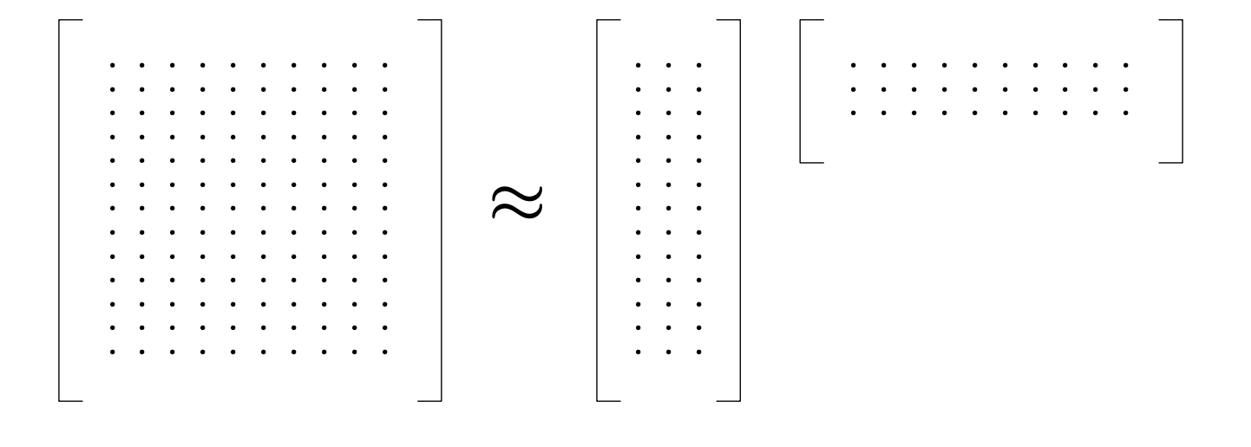
Matrix Factorization
A
B
C
Using matrix factorization we can represent our original feature matrix as the multiplication of two smaller matrices
A = BC
Outer dimensions match original matrix (n observations and m features)
Inner dimensions depend on method and hyperparameters – but can be used for feature interpretation

Slide 15
Matrix Factorization Benefits
Provide a compressed representation of the original matrix
The B matrix forms a condensed representation of the features.
The new features can be thought of as linear combinations of the original features
The new features represent similar groupings of the original features

Slide 16
Text Analysis Example
If we want to analyze text, we might collect observations from multiple sources (books,passages,essays).
The features we could extract would be the frequency of a word appearing. We might track 50,000 words.
The feature matrix is going to be sparse. (many observations are going to have zero occurrences of 50,000 unique words)
We want to represent this data in lower dimension space – matrix factorization to the rescue.

Slide 17
Text analysis
Observation Matrix (books x topic)
Observation Matrix (topic x word occurrence)
Feature Matrix (books x word occurrence)

Slide 18
Principal Component Analysis (PCA)
Identifiers clusters of correlated variables
Replaces each cluster with a single variable (principal component)
The components are orthogonal and form a new coordinate system
Approximate factorization of the feature matrix X ≅ T W^{T} T = XW X is n x p, W is p x l, T is n x l

Slide 19
Principal Component Analysis (PCA)
Compute a covariance matrix (X^{T}X)
Diagonalize covariance matrix to get eigenvectors and eigenvalues
Eigenvectors are the principal components
Eigenvalues give you the explained variance of each component
In reality, we don't do this:
Covariance matrix will be very large
We use randomized algorithms or SVD to avoid computing the covariance matrix
Good libraries (e.g., scikit-learn) should provide implementations

Slide 20
PCA Example
SVD Example
https://towardsdatascience.com/understanding-singular-value-decomposition-and-its-application-in-data-science-388a54be95d

